Slide 1


Advanced Portfolio Management Implementing Technical Strategies for Superior Returns
PRESENTED BY
Group:
Anshul Dave, Deepthi Rao, Miranda Chung, Raunak Ghawghawe, Yash Makadia

Slide 2

1
Portfolio Overview
5
Portfolio vs Individual Components
2
Strategy Methodology
AGENDA
6
Portfolio vs SPY
3
Analysis & Findings
7
Variations of Equal Weighted Portfolios
4
Equal Weights vs MVO

Slide 3
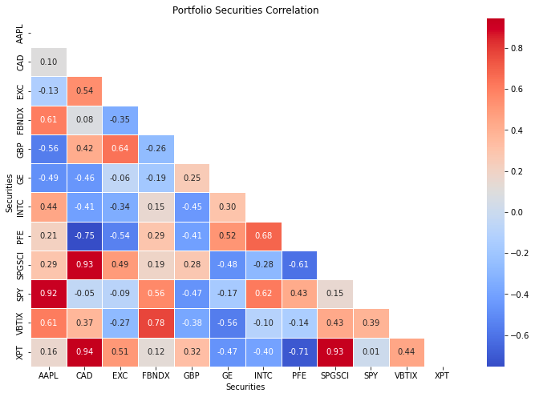
Portfolio Overview
EQUITIES
Apple (AAPL), Exelon Corp (EXC), General Electic (GE), Pfizer (PFE), S&P 500 ETF (SPY)
FIXED INCOME
Fidelity Investment Grade Bond Index (FBNDX)
COMMODITY
S&P GSCI Broad Commodity Index
(SPGSCI)
CURRENCY PAIR
British Pound
(GBP)

Slide 4
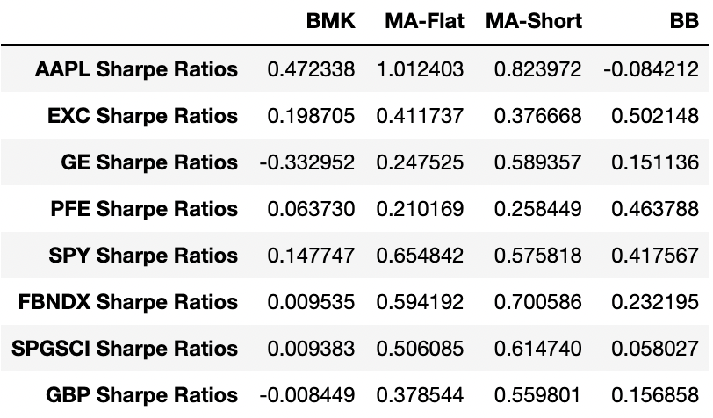
Strategy Methodology
MA CROSSOVER
Fast window = 11 | Slow window = 220
FLAT
SHORT
AAPL, FBNDX
GE, SPGSCI, GBP
BOLLINGER BAND
WIndow = 22 | STD DEV Band= 2
EXC, PFE, SPY

Slide 5
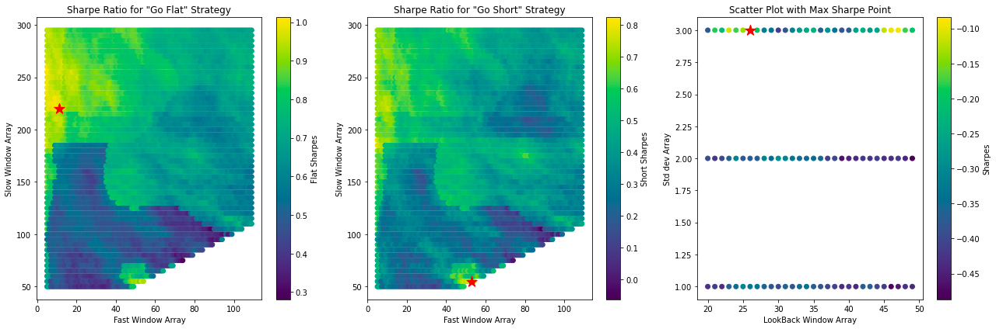
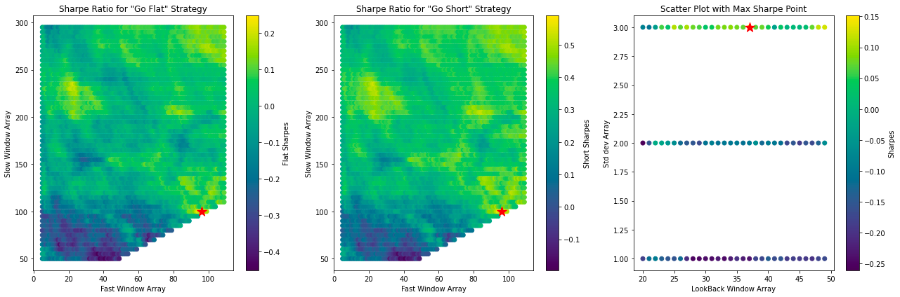
Determining Optimal Windows: MA Crossover
APPLE (AAPL)
GENERAL ELECTRIC (GE)

Slide 6
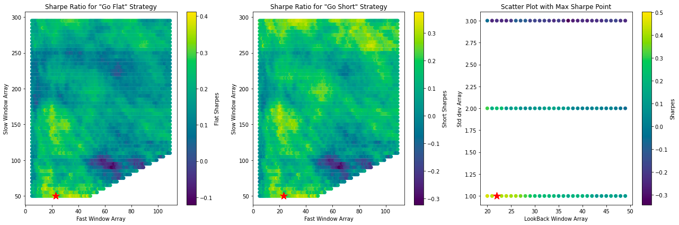
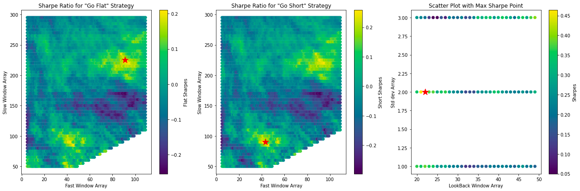
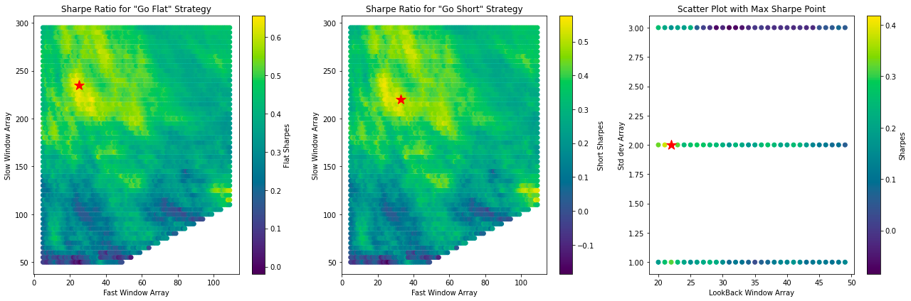
Determining Optimal Windows: Bollinger Band
EXELON CORP (EXC)
PFE
SPY

Slide 7
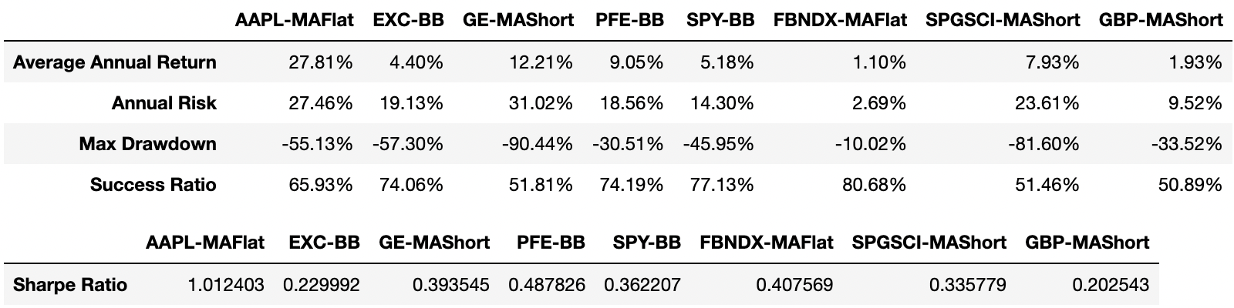

Analysis & Findings
Portfolio Summary Statistics
Problem 3

Slide 8
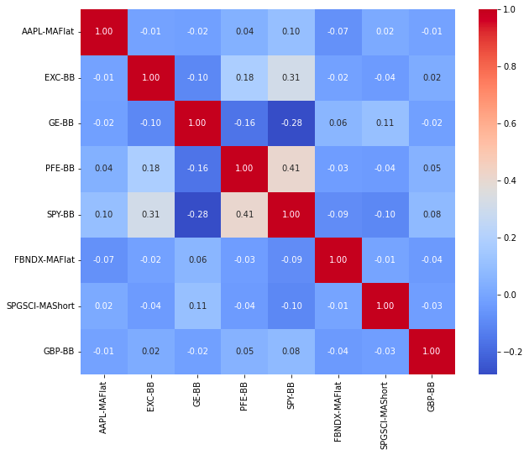
Analysis & Findings
Portfolio Correlation Structure
Problem 3

Slide 9
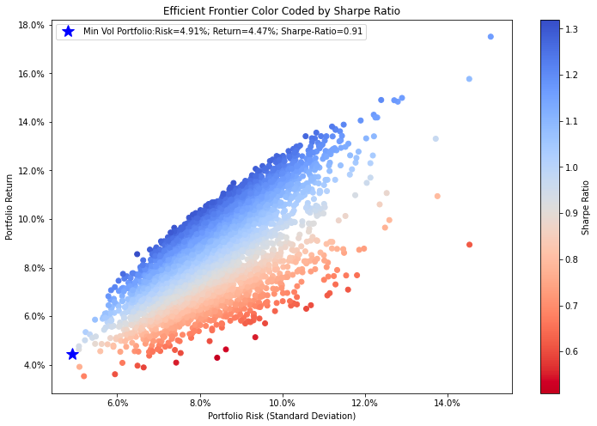
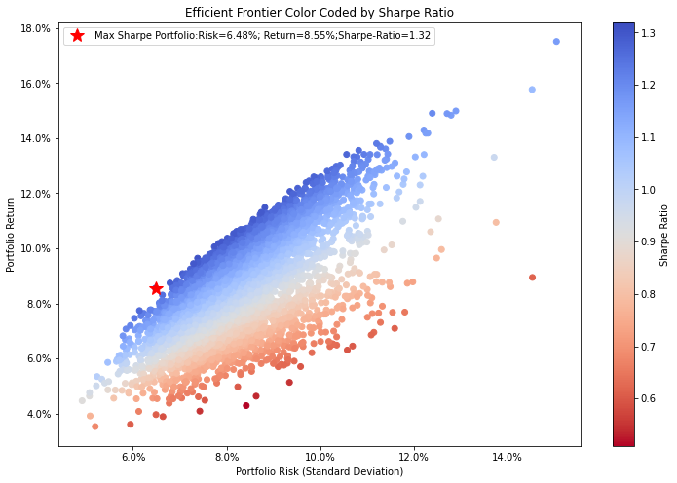
Risk/Return Scatter Plots
Mean Variance Optimization approach using chosen strategies
Min Sharpe = 0.91 | Max Sharpe = 1.313

Slide 10
Equal Weights vs MVO
Comparison
0.522
1.32
VS
EQUAL WEIGHTS PORTFOLIO SHARPE
MAX SHARPE FROM MVO BEST PORTFOLIO
CONCLUSION
There is a more favorable risk-adjusted return profile for the MVO approach compared to the uniform allocation method.

Slide 11
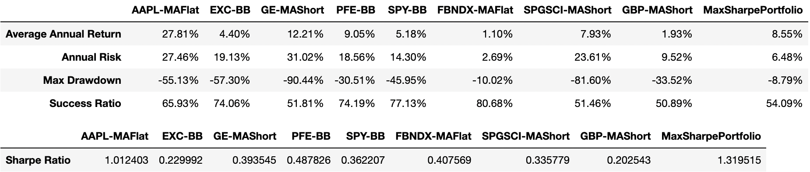
Comparative Analysis
How does the final portfolio compare with the individual components?

Slide 12
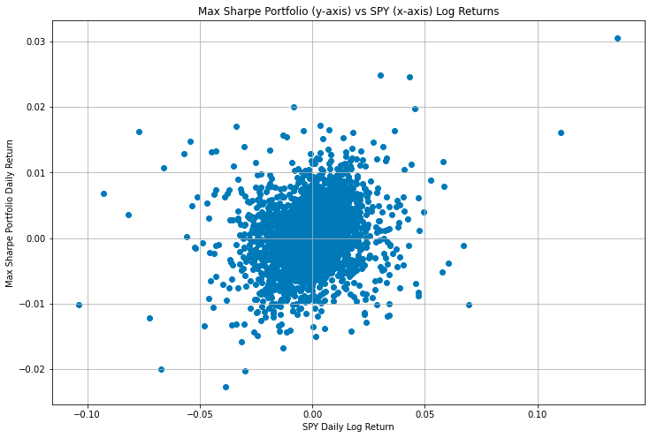
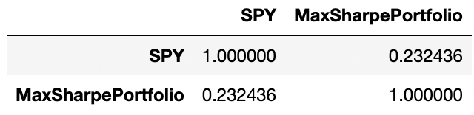
Max Sharpe Portfolio vs SPY
Relationship Visualization
Correlation
Max Sharpe Portfolio Beta
0.078

Slide 13
Variations of the Equal Weighted Portfolio
CONCLUSION
The Max Sharpe Portfolio demonstrates exceptional performance. It not only surpasses the other portfolios, but it surpasses by a significant margin.

Slide 14
THANK YOU!
Any questions?

